Slide 1
HUDs Office of Special Needs Assistance Programs (SNAPS) Updates
Karen DeBlasio, Division Director, Office of Special Needs Assistance Programs (SNAPS)
June 22, 2022

Slide 2
Today’s Agenda
SNAPS Budget
Continuum of Care Program
Emergency Solutions Grants/ESG CV Allocations
Youth Homelessness Demonstration Program

Slide 3
Budget Homeless Assistance Grants (HAG) and Other Spending
 | FY2021 Appropriated | FY2022 Appropriated | FY2023 Requested
Homeless Assistance Grants
Emergency Solutions Grants | $290 | $290 | $290
Continuum of Care | $2,5690 | $3,213 | $3,197
Domestic Violence Grants* | $52 | $52 | $52
Youth Demonstration & youth TA | $82 | $82 | $82
HMIS | $7 | $7 | $7
Total Homeless Assistance Grants | $3,000 | $3,644 | $3,628
Other Homeless Funds
Youth System Improvement | N.A | $25 | $
The Domestic Violence Grants are awarded to projects that will serve survivors of domestic violence. These grants are awarded through HUD's CoC Program Competition process.
Included in the CoC request was $316 million for grants to support CoCs as they work with other housing or healthcare partners, to expand CES, expand street outreach, and expand HMIS.
Notes:
$3.213 billion for HUD’s homeless assistance grants, which will be sufficient to renew existing projects. There is an additional $52 million for new projects dedicated to survivors of domestic violence and $107 million dedicated to youth experiencing homelessness with $72 million of that for additional YHDP, $10 million for Youth-focused TA, and $25 million “for youth homelessness system improvement grants to support communities, including but not limited to the communities assisted under the matter preceding this proviso, in establishing and implementing a response system for youth homelessness, or for improving their existing system.”

Slide 4
CoC Competition Updates
FY22 CoC Competition:
SNAPS recently updated the Continuum of Care (CoC) Registration Notice (CPD-22-02). The Notice is available via the HUDClips page and the CoC Competition page on HUD.gov.
FY22 CoC Registration closed in April
Expect FY2022 NOFO to be out SOON

Slide 5
Updated CoC Analysis Tool: Race and Ethnicity - Version 3.0 Released in March 2022
Race and Ethnicity data pulled from Point-In-Time Count (PIT) and American Community Survey (ACS) data
PIT data are pulled from PIT 2021.
ACS data are pulled from ACS 2015-2019 5-Year estimates.
Facilitates analysis of racial disparities among people experiencing homelessness.
Critical first step in identifying and changing racial and ethnic disparities in our systems and services.
https://www.hudexchange.info/resource/5787/coc-analysis-tool-race-and-ethnicity/

Slide 6
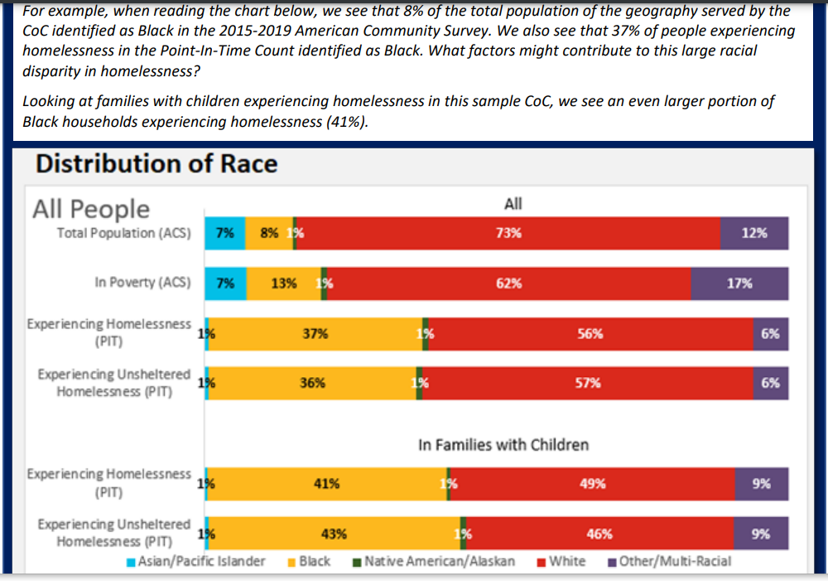
Updated CoC Analysis Tool: Race and Ethnicity - Version 3.0 Released in March 2022

Slide 7
ESG CV- Progressive Deadline Updates
The ESG CV Notice (CPD-21-08) set forth progressive expenditure deadlines for your ESG CARES allocation:
Expend 20% of the entire allocation by September 30th, 2021- recapture letters went out 3/16/22
Expend 80% of the entire allocation by March 31, 2022; HUD will NOT recapture based on this deadline
Expend 50% of the entire allocation by June 16th; This deadline is new; added in NOTICE CPD-22-06.
Expend the entire allocation by September 30th, 2022.
In addition to these deadlines recipients are expect to draw at least quarterly in IDIS and to report on persons served and financial data in Sage quarterly
Notes:
The Sept. 2021 deadline has come and gone and HUD worked with recipients who did not meet the deadline and recently sent letters out recapturing approximately $16 million. These funds will be reallocated to recipients who met the deadline and have spent at least 30% of their allocation.
This was not meant to be punitive and will NOT impact your “regular” ESG allocation. This was done to shift money to places that have exceeded the deadline so it will continue to be spent in the local area.

Slide 8
Expedited Regulatory Waivers- New Notice – June 15, 2022
https://www.hud.gov/sites/dfiles/OCHCO/documents/2022-09cpdn.pdf
Notice CPD-22-09
Many “pandemic” waivers expired in March, but some flexibilities are still needed
(i.e., Fair Market Rent (FMR) waivers for ESG)
Can only ask for expedited waivers for waivers explicitly stated in the notice. This includes:
CoC/YHDP - Suitable Dwelling Size and Housing Quality Standards
CoC/YHDP - Fair Market Rent for Individual Units and Leasing Costs
CoC/YHDP – One - Year Lease Requirement
CoC/YHDP - Permanent Housing Rapid Re-housing Limit to 24 Months of Rental Assistance
CoC/YHDP Disability Documentation for Permanent Supportive Housing

Slide 9
Expedited Regulatory Waivers- New Notice – June 15, 2022
ESG – Assisting Program Participants with Subleases
ESG - Durational Limits on Housing Relocation and Stabilization Services
ESG - 24-Month Limit on Rental Assistance
ESG - Restriction of Rental Assistance to Units with Rent at or Below FMR
HOPWA – Time Limits for Short-Term Housing Facilities and Short-Term Rent, Mortgage, and Utility Payments
HOPWA – Space and Security
HOPWA – Self-Certification of Income and Credible Information on HIV Status

Slide 10
Youth Homelessness Demonstration Projects (YHDP)
NOFO OPEN- Closing Soon!
FY2021 Notice of Funding Opportunity (NOFO)
Includes $72 million for up to 25 communities with a priority for up to 8 communities with a substantial rural population
Due in one week- June 28th
As seen on earlier budget slides:
FY 2022 budget: $72 million for up to 25 communities with a priority for up to 8 communities with a substantial rural population AND
$25 million for youth homeless systems improvement grants

Slide 11
Special NOFO- Unsheltered – Released Today 6/22
On June 22nd,SNAS released a Special NOFO to Address Unsheltered and Rural Homelessness (Special NOFO)
Purpose of the NOFO is to target efforts to reduce unsheltered homelessness, particularly in communities with very high levels of unsheltered homelessness and homelessness in rural areas.
HUD will award funding to communities to implement coordinated approaches -- grounded in Housing First and public health principles -- to reduce the prevalence of unsheltered homelessness, and improve services engagement, health outcomes, and housing stability among highly vulnerable unsheltered individuals and families.
HUD expects applicant communities to partner with health and housing agencies to leverage mainstream housing and healthcare resources.
Approximately $322,000,000 is available in this Special NOFO.
Of this amount, $54,500,000 is available only for projects that serve rural areas as defined in the Special NOFO
$267,500,000 is available for projects as part of the Unsheltered Homelessness Set Aside.

Slide 12
SNAPS List Servs
Stay up to date on HUD’s Special Needs Assistance Programs (SNAPS) news and updates for grantees and interested stakeholders:
Sign up for SNAPS Competition Information through HUD.gov
Sign up for SNAPS Program Information through HUD.gov
Sign up for SNAPS Technical Assistance Information through HUD Exchange

Slide 13
Questions?

